Slide 1



Slide 2
About Today…
State Management
Session
Cookie

Slide 3
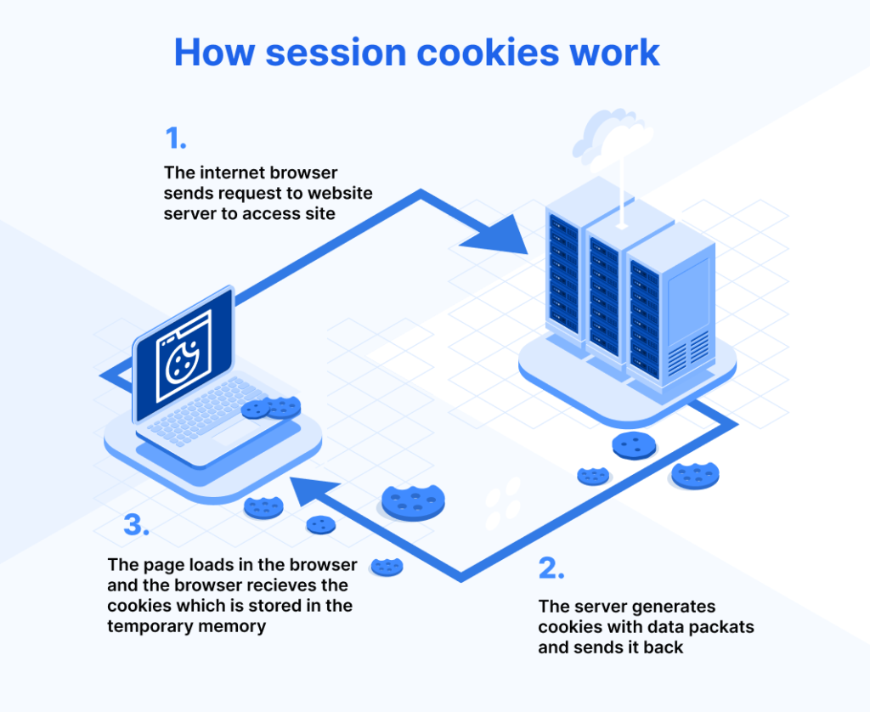

Slide 4
Intro to Sessions and Cookies
Sessions
Store user data on the server for a particular user, accessible across multiple requests
Cookies
Small pieces of data stored on the client's browser to remember information about the user

Slide 5
Importance of Sessions and Cookies
Why Use Sessions?
Track user authentication
Maintain user preferences
Secure user data
Why Use Cookies?
Store small amounts of data client-side
Track user activity
Improve user experience

Slide 6

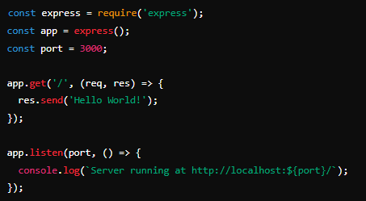
Setting Up Express.js
Install Express.js
Why Use Cookies?

Slide 7

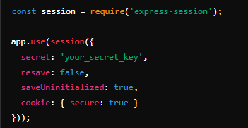
Installing and Using ‘express-session’
Install ‘express-session’
Basic Usage

Slide 8
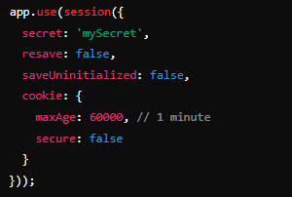
Session Configuration Options
Options
secret
A string used to sign the session ID cookie
resave
Forces the session to be saved back to the session store
saveUninitialized
Forces a session that is "uninitialized" to be saved
cookie
Configures the session cookie
Example Configuration

Slide 9

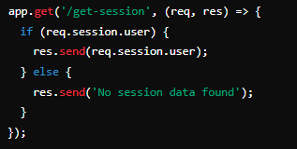
Storing and Retrieving Session Data
Storing Data
Retrieving Data

Slide 10


Intro to Cookies in Express.js
Basics
Set, read, and clear cookies in the user's browser
Installing ‘cookie-parser’
Using ‘cookie-parser’

Slide 11

Setting Cookies
Setting a Simple Cookie

Slide 12
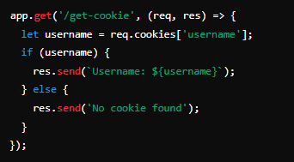
Reading Cookies
Reading a Cookie

Slide 13

Deleting Cookies
Clearing a Cookie

Slide 14

Security Considerations
Session Security
Use ‘secure’ cookies with HTTPS
Use a strong ‘secret’
Regenerate session IDs
Cookie Security
Use ‘httpOnly’ to prevent JavaScript access
Use ‘secure’ to ensure cookies are sent over HTTPS
Set ‘SameSite’ attribute to prevent CSRF

Slide 15

What is the primary difference between sessions and cookies in
Express.js?
Sessions store data on the server side, while cookies store data on the client side
Which middleware is used to handle sessions in Express.js?
express-session
Which option in express-session middleware ensures that a session is not saved unless it is modified?
resave
How can you configure a cookie to be accessible only over HTTPS?
Set ‘secure: true’

Slide 16

Task
Build a simple user authentication system using sessions and cookies in Express.js.

